Slide 1
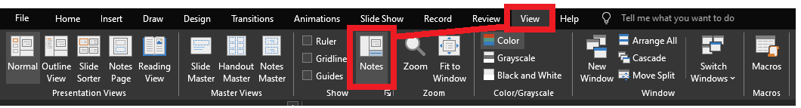
Reviewing after the presentation?
Be sure to enable the Notes for slide-specific content

Slide 2

LIKE, to the max!
(Beyond the % symbol)

Slide 3
stringable1 LIKE stringable2
SELECT [name], [description]
FROM [SomeTable]
WHERE [description] LIKE ...
“Stringable” refers to anything that can be represented as a string, including numerics, datetimes, guids, etc.

Slide 4
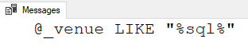
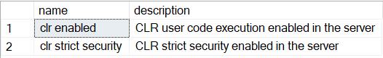
stringable1 LIKE stringable2
DECLARE @_venue varchar(20)
= 'SQL Saturday 20XX'
IF @_venue LIKE '%sql%'
PRINT '@_venue LIKE "%sql%"'
Stringable1 is usually the column (variable-length string)
Stringable2 is usually the shorter string of some pattern to find
Returns boolean
SELECT [name], [description]
FROM master.sys.configurations
WHERE [description] LIKE 'clr%'

Slide 5
% – Wildcard of any length (even zero)
WHERE Column1 LIKE '%' -- returns non-NULLs
WHERE Column1 LIKE 'A%' -- returns values starting with A
WHERE Column1 LIKE '%A' -- returns values ending with A
WHERE Column1 LIKE 'A%B' -- returns values starting with A
and ending with B
WHERE Column1 LIKE '%B%' -- returns values containing B

Slide 6

%

Slide 7

_
[]
[-]
[^]
%
ESCAPE

Slide 8

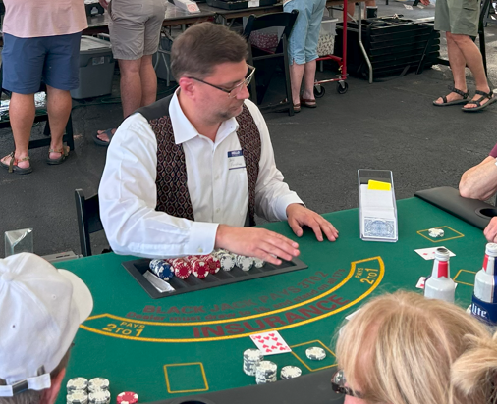
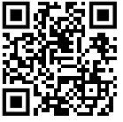


Jeff Foushee
SQL Server Database Admin
Programmer
SQL Saturday speaker
Blackjack dealer
https://www.linkedin.com/in/jeff-foushee/
https://github.com/jbfoushee/MyPresentations/

Slide 9
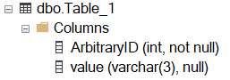
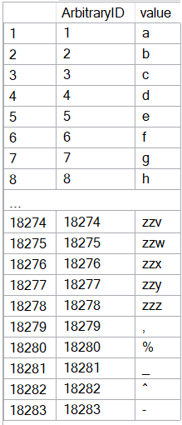
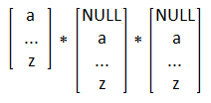
CREATE TABLE dbo.Table_1
( ArbitraryID int IDENTITY(1,1) NOT NULL, [value] varchar(3) )
SET NOCOUNT ON
DECLARE @_text2 varchar(26) = 'abcdefghijklmnopqrstuvwxyz'
DECLARE @_text1 varchar(26) = @_text2
DECLARE @_text0 varchar(26) = @_text1
DECLARE @_p2 tinyint = 0
DECLARE @_p1 tinyint = 0
DECLARE @_p0 tinyint = 0
WHILE 1 = 1
BEGIN
SET @_p2 +=1
IF @_p2 > 26
BEGIN
SET @_p1 += 1
SET @_p2 = 1
END
IF @_p1 > 26
BEGIN
SET @_p0 += 1
SET @_p1 = 1
END
IF @_p0 > 26
BREAK
DECLARE @_text varchar(3) = CONCAT(
SUBSTRING(@_text0, @_p0, 1)
, SUBSTRING(@_text1, @_p1, 1)
, SUBSTRING(@_text2, @_p2, 1) )
INSERT INTO dbo.Table_1 (value) VALUES (@_text)
END
INSERT INTO [dbo].[Table_1] ([value]) VALUES(','), ('%'), ('_'), ('^'), ('-')
INSERT INTO [dbo].[Table_1] ([value]) VALUES(','), ('%'), ('_'), ('^'), ('-')

Slide 10
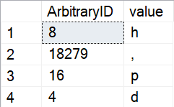
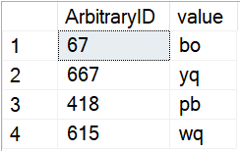
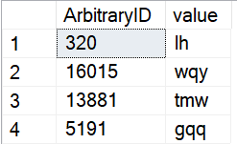
_ – Wildcard of one character (i.e. non-zero length)
SELECT TOP 4 *
FROM dbo.Table_1
WHERE Column1 LIKE '_'
ORDER BY NEWID() -- randomizer
SELECT TOP 4 *
FROM dbo.Table_1
WHERE Column1 LIKE '__'
ORDER BY NEWID() -- randomizer
SELECT TOP 4 *
FROM dbo.Table_1
WHERE Column1 LIKE '__%'
ORDER BY NEWID() -- randomizer

Slide 11
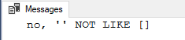
[] – Containment characters
By themselves do nothing
DECLARE @_value varchar(20) = ''
IF @_value LIKE '[]'
PRINT 'yes, '''' LIKE []'
ELSE
PRINT 'no, '''' NOT LIKE []'

Slide 12
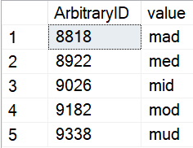
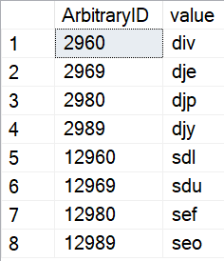
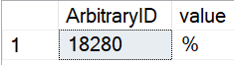
[] – Containment characters
Represent a non-delimited array of allowable characters as one position
% and _ lose their special wildcard ability inside the containment characters
NULL/blank are not acceptable entries for this list
WHERE [value] LIKE 'm[aeiou]d'
WHERE ArbitraryID LIKE '%[2%]9[86][90]'
WHERE [value] LIKE '[%]'

Slide 13
Is LIKE case-sensitive?
No functions, not even UPPER() and LOWER() are case-sensitive
Do you need to follow/enforce something other than the current collation?

Slide 14
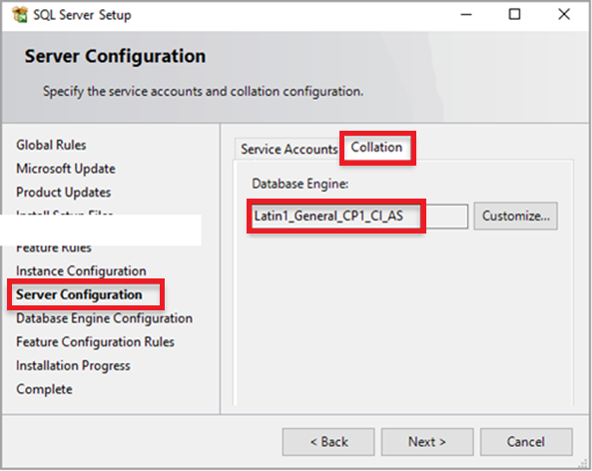
The Collation (Case-Sensitivity) Hierarchy
Instance – What was set when SQL Server was first installed?
SELECT SERVERPROPERTY('collation')
TempDB is built off this collation as a clone of master. So any temp tables will have this collation.

Slide 15
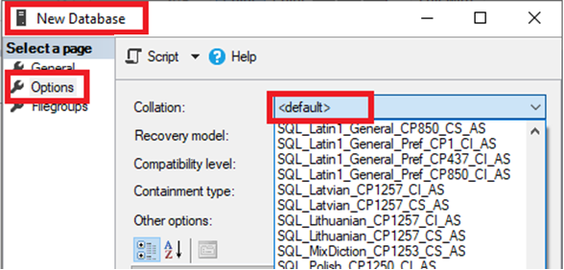
The Collation (Case-Sensitivity) Hierarchy
Instance – What was set when SQL Server was first installed?
Copies the current instance-level collation
Database – Default or explicit?
IF 'A' = 'a'
PRINT 'Case-insensitive database'
ELSE
PRINT 'Case-sensitive database'
SELECT [name], collation_name
FROM [master].[sys].[databases]
WHERE name = DB_NAME()
SELECT DB_NAME(), DATABASEPROPERTYEX(DB_NAME(), 'collation')

Slide 16
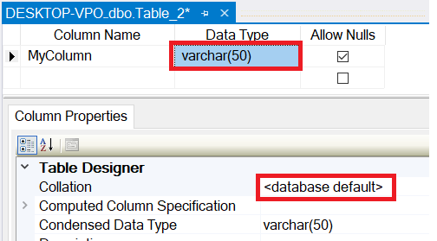
The Collation (Case-Sensitivity) Hierarchy
Instance – What was set when SQL Server was first installed?
Database – Default or explicit?
Table Column – Database default or explicit?
Copies the current database-level collation
SELECT TABLE_SCHEMA, TABLE_NAME, COLUMN_NAME
, DATA_TYPE
, COLLATION_NAME
, CASE Convert(varchar,IsNull(COLLATION_NAME, ''))
WHEN '' THEN ''
WHEN Convert(varchar, DATABASEPROPERTYEX(DB_NAME(), 'collation')) THEN ''
ELSE '*'
END AS Not_As_DB_Collation
FROM INFORMATION_SCHEMA.COLUMNS
ORDER BY TABLE_SCHEMA, TABLE_NAME, COLUMN_NAME

Slide 17
The Collation (Case-Sensitivity) Hierarchy
Instance – What was set when SQL Server was first installed?
FROM Table_1 t1
INNER JOIN Table_2 t2
ON t1.SomeColumn
COLLATE
SQL_Latin1_General_CP1_CI_AS
= t2.SomeColumn
Database – Default or explicit?
FROM Table_1 t1
INNER JOIN Table_2 t2
ON t1.SomeColumn = t2.SomeColumn
Table Column – Database default or explicit?
Cannot resolve the collation conflict between "SQL_Latin1_General_CP1_CI_AS" and "Latin1_General_CI_AS" in the equal to operation.
Query-level – temporarily treat it differently for calculation purposes

Slide 18
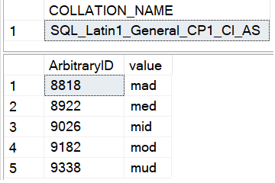
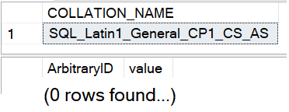
Is LIKE case-sensitive?
No functions, not even UPPER() and LOWER() are case-sensitive
Do you need to follow/enforce something other than the current collation?
-- Request column collation
SELECT isc.COLLATION_NAME
FROM INFORMATION_SCHEMA.COLUMNS isc
WHERE isc.TABLE_NAME = 'Table_1'
AND isc.COLUMN_NAME = 'value’
-- Original query results in CAPS
SELECT t1.ArbitraryID, t1.[value]
FROM Table_1 t1
WHERE t1.[value] LIKE 'M[AEIOU]D'

Slide 19
What if I need to worry about case-sensitivity?
No functions, not even UPPER() and LOWER() are case-sensitive
Do you need to follow/enforce something other than the current collation?
Forcing case-sensitivity on an case-insensitive column:
WHERE [CI_value] COLLATE Latin1_General_CS_AS LIKE 'm[aeiou]d'
Forcing case-insensitivity on an case-sensitive column:
WHERE [CS_value] COLLATE Latin1_General_CI_AS LIKE 'm[aeiou]d'
WHERE [CS_value] LIKE '[mM][aAeEiIoOuU][dD]'
WHERE LOWER([CS_value]) LIKE 'm[aeiou]d'

Slide 20
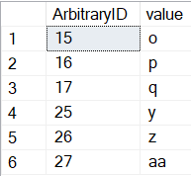
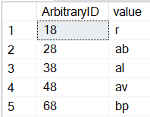
[-] – Range character
Provides a shortcut to consolidate characters on its immediate left and right
Characters must be contiguous. Lower value must be on the left.
WHERE [ArbitraryID] LIKE '[1-2][5-7]'
WHERE [ArbitraryID] LIKE '[1-46]8'
1 5
2 6
7
1
2
3 8
4
6

Slide 21
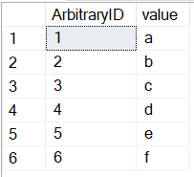
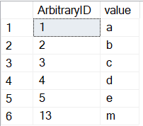
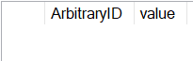
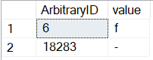
[-] – Range character
Provides a shortcut to consolidate characters on its immediate left and right
Characters must be contiguous. Lower value must be on the left.
WHERE [value] LIKE '[a-f]'
WHERE [value] LIKE '[a-em]'
WHERE [value] LIKE '[f-a]'
WHERE [value] LIKE '[-f]'

Slide 22
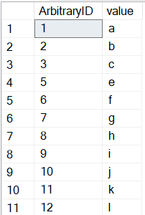
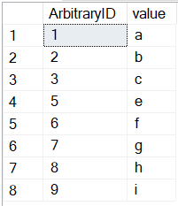
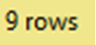
[^] – Negation character
Provides a “NOT” to all characters on its right
Must be the FIRST character within the containment characters to take effect
WHERE [ArbitraryID] LIKE '[^4]'
WHERE [ArbitraryID] NOT LIKE '[4]'

Slide 23
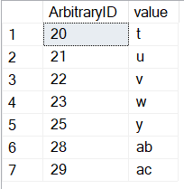
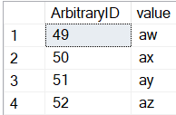
[^] – Negation character
Provides a “NOT” to all characters on its right
Must be the FIRST character within the containment characters to take effect
WHERE [ArbitraryID] LIKE '2[^467]'
WHERE [value] LIKE 'a[^a-v]'

Slide 24
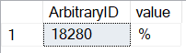
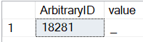
ESCAPE stringable
WHERE [value] LIKE '%\%%' ESCAPE '\'
WHERE [value] LIKE '%!_%' ESCAPE '!'

Slide 25
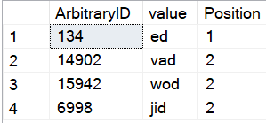
PATINDEX(like_pattern, stringable)
Returns the starting position of the first occurrence of a pattern in a specified expression, or zero if the pattern is not found, on all valid text and character data types.
(our familiar patterns)
SELECT TOP 4 ArbitraryID
, [value]
, PATINDEX('%[aeiou]d', [value]) AS Position
FROM dbo.Table_1
WHERE [value] LIKE '%[aeiou]d'
ORDER BY NEWID() -- randomizer

Slide 26
On the horizon, true RegEx…
https://devblogs.microsoft.com/azure-sql/introducing-regular-expression-regex-support-in-azure-sql-db/
Function | Description
REGEXP_LIKE() | This function returns TRUE if a string matches a regular expression pattern, or FALSE otherwise
REGEXP_COUNT() | This function returns the number of times a regular expression pattern matches in a string
REGEXP_INSTR() | This function returns the starting or ending position, based on the specified option, of the given occurrence of a regular expression pattern in a string.
REGEXP_REPLACE() | This function returns a substring that matches a regular expression pattern from a string.
REGEXP_SUBSTR() | This function returns a modified string replaced by a ‘replacement string’, where occurrence of the regular expression pattern found.

Slide 27
Jeff Foushee
SQL Server Database Admin
Programmer
SQL Saturday speaker
Blackjack dealer
https://www.linkedin.com/in/jeff-foushee/
https://github.com/jbfoushee/MyPresentations/

Slide 28

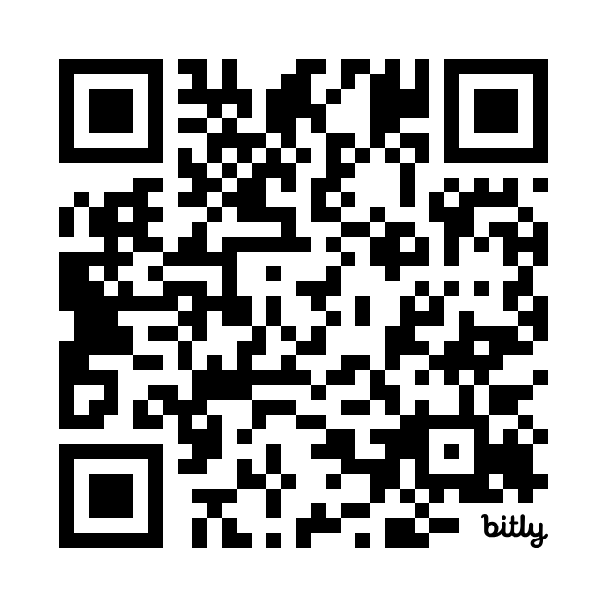

LIKE, to the max! (Beyond the % symbol)
https://github.com/jbfoushee/MyPresentations/
Scan the QR code to submit session evaluations.

